Slide 1
Dublin Bus App
Paul Dinesh Augustine (10515229)
Ravi TejA gadde (10517744)

Slide 2
RTPI REST Web Services API
JSON or XML format
API is available in the RTPI servers
Details are updated on daily basis of the information on routes and operators
Provided by the National Transport Agency

Slide 3

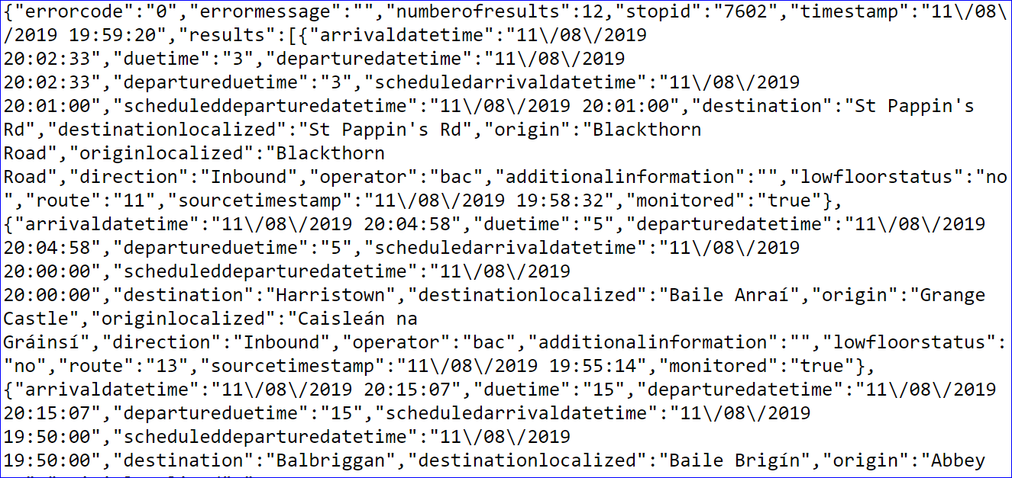
RTPI REST Web Services API

Slide 4
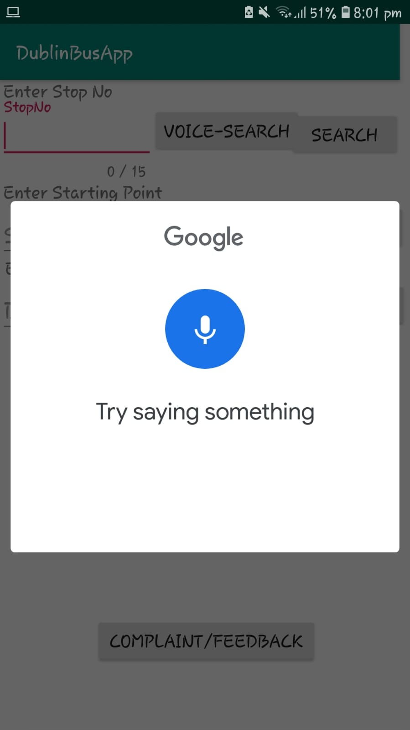
Voice Search
Uses built-in voice recognition feature
Transcribes the user’s speech input
Quite useful to avoid manual input
of the search term
Works for English Language
Options are available to choose
different language

Slide 5
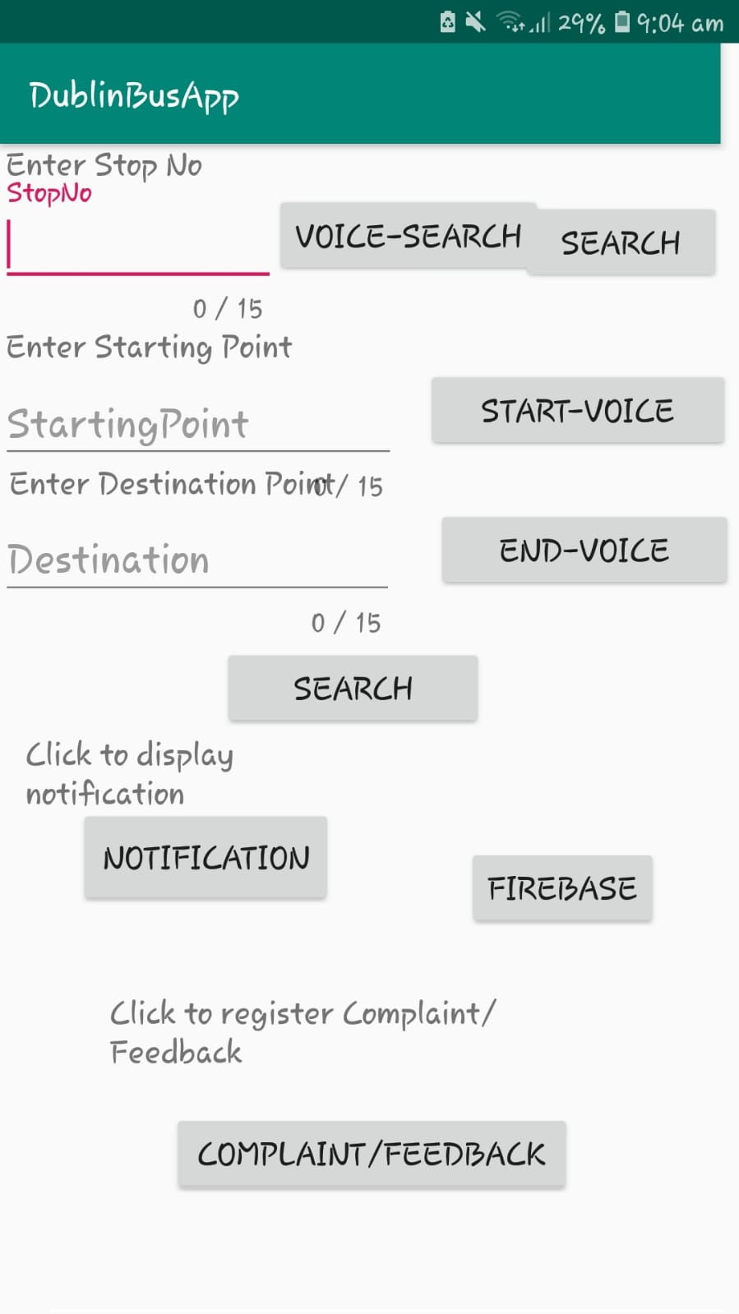
Design of the App
Voice-search button enables user to input the search real time bus information Stop No using Speech input.
Alternatively, user can search the real time bus information for a stop using search button.
User can enter starting point & destination point using Start-Voice & End-Voice button using Speech input.
Alternatively, it can be done using the Search button
The Notification button displays the recent searched bus route & time remaining information as notification.
Complaint/Feedback button directs the user to the complaint and feedback page of Dublin bus where user can register a complaint or Feedback or a query.

Slide 6
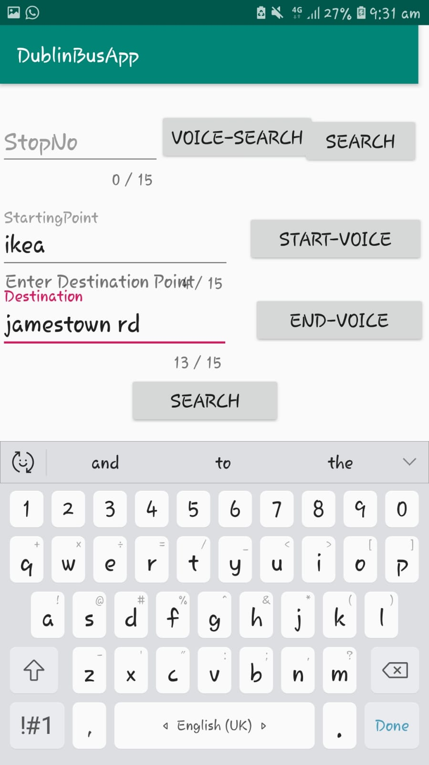
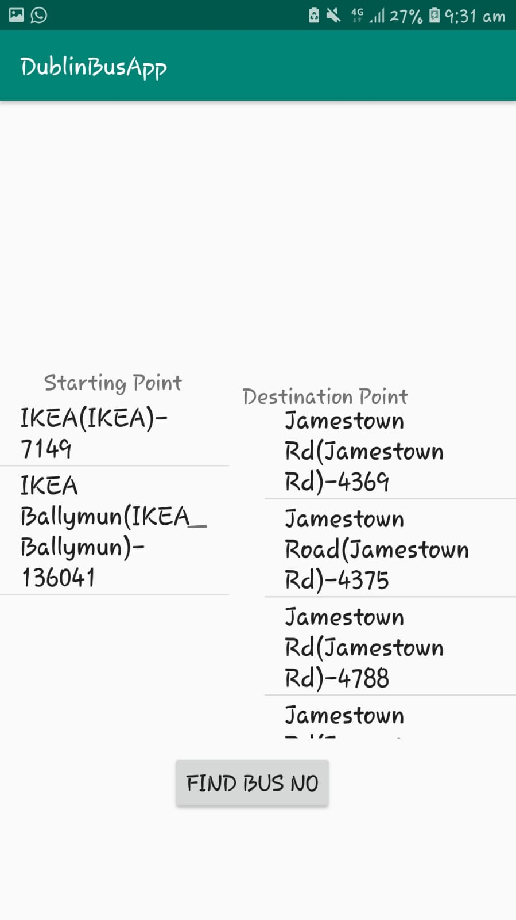
Search
Starting point –ikea
Destination point – Jamestown rd
The results for the search input

Slide 7
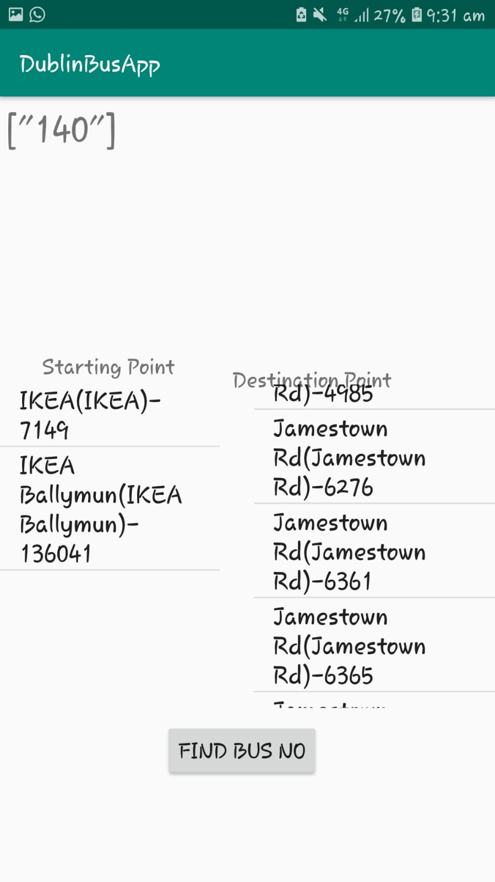
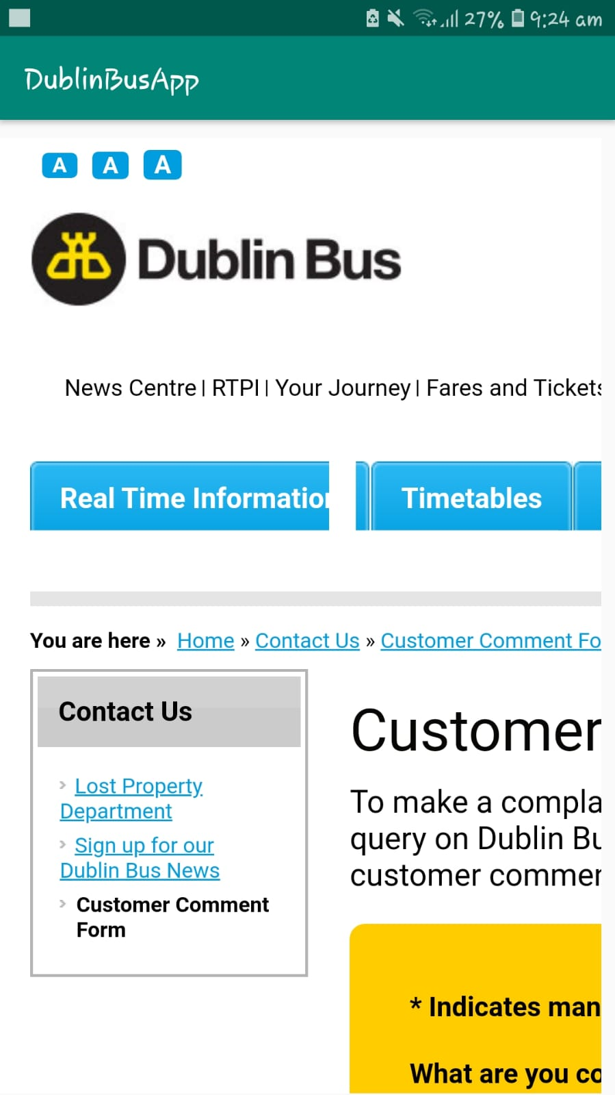
The common Route for the selected Starting and destination points are shown
Complaint/Feedback/Query form

Slide 8
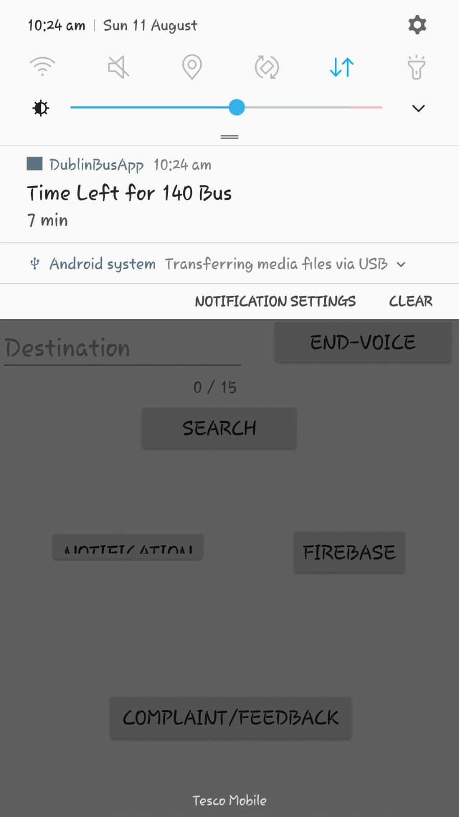
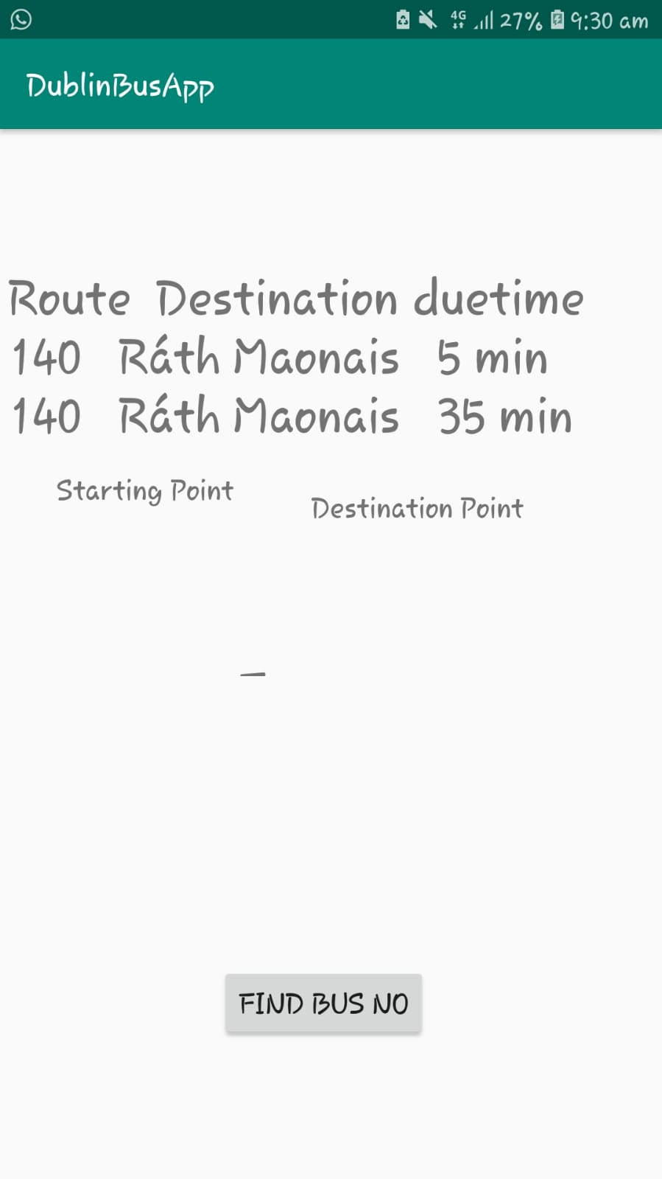
Real Time Data
Search result for the stop 6361
Shows the real time data of the bus
Notification of bus 140 and time

Slide 9
Future Development
Firebase
Speech to text for Notification
Finding nearby stops of my location
Finding exact bus location
Expected time for bus to reach bus stop
Call emergency No. through the app
Allow the user to send location & a default pre-defined message to friends & family during emergency situations.

